Slide 1

Multiverse Path Encryption
Securing Interpretation under Adversarial Access
Shaoyuan Wu • Yinning Zhang
August 03, 2026
IEEE IMNS 2026 / SECURE AND TRUSTWORTHY AI
Notes:
Good morning. I’m Shaoyuan Wu.
Today, I will present Multiverse Path Encryption, MPE. The name is inspired by the concept of Many-Worlds Interpretation: an observed path exists alongside multiple coherent alternative paths.
MPE translates a branching-world intuition into a framework for post-compromise security.
Our central question is: if an adversary can already observe ciphertext-derived outputs or queryable system states, can we still prevent reliable interpretation?
Traditional encryption seeks to prevent access, while MPE seeks to control what access can reveal reliably.

Slide 2


Shaoyuan Wu, Ph.D., M.S., LL.M., B.S.
OMSCS Student, Georgia Institute of Technology
Director, Global AI Governance and Policy Research Center, EPINOVA LLC
Specially-invited Associate Professor, Sun Yat-sen University
Assistant Professor, National Institute for South China Sea Studies
Email: sywu@epinova.org
ORCID: 0009-0008-0660-8232
Yinning Zhang, M.Sc., M.Ed., M.E., B.S.Ed.
Ph.D. Student, Kennesaw State University
Adjunct Professor, University of West Georgia
Instructional Designer, eCampus
Email: yzhang56@students.kennesaw.edu
Notes:
Here is the short bio of the authors.

Slide 3
CONTENTS
01
Research Question
02
System Architecture
03
Experimental Evidence
04
Security Meaning & Limits
Notes:
For today's presentation, I will concentrate on the technical idea, the architecture, and the experimental evidence.

Slide 4
1. Research Question
Traditional cryptography
Post-compromise reality
Prevent plaintext recovery
Outputs may already be visible
However
Attackers may observe symbolic outputs, textual traces, or query responses without necessarily having a clean, authenticated plaintext.
Notes:
Traditional cryptography primarily protects against unauthorized plaintext recovery.
Post-compromise access changes the attacker's position, because the attacker may already observe symbolic outputs, textual traces, or query responses.
However, visibility alone does not show whether those observations support a reliable operational interpretation.

Slide 5
1. Research Question
Can the attacker resolve the intended interpretation reliably enough to select a target, reconstruct a path, or prioritize an action?
MPE
ACCESS ≠ RELIABLE INTERPRETATION
Notes:
The attacker still needs to determine which target matters, which path is real, and which action should be prioritized. This creates a second security problem besides visibility, which is what the adversary can infer from it confidently.
In other words, can the attacker resolve the intended interpretation reliably enough to select a target, reconstruct a path, or prioritize an action?
MPE addresses this by separating access from reliable interpretation.
The system does not merely hide one message. Instead, it allows multiple coherent interpretations to remain viable under the attacker's observations.
In short, access does not automatically produce an authenticated or uniquely actionable meaning.

Slide 6
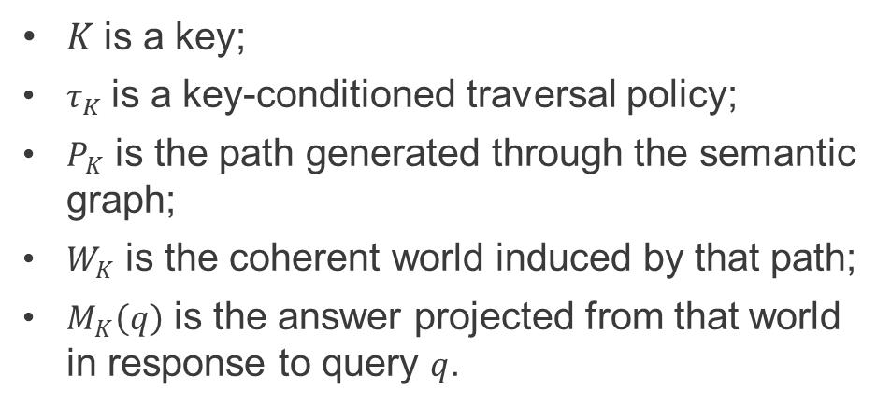
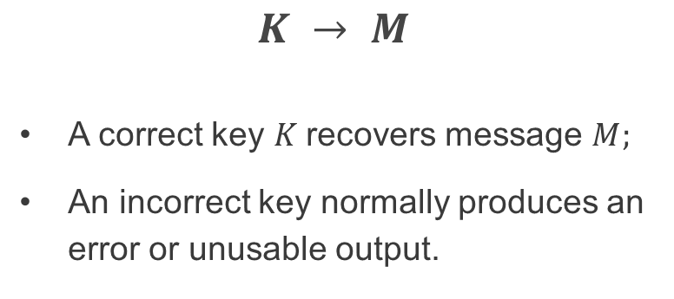
2. System Architecture: Core Mechanism
$$K → τₖ → Pₖ → Wₖ → Mₖ(q)$$
Conventional Encryption
MPE
$K$is a key;
$τ_{K}$is a key-conditioned traversal policy;
$P_{K}$ is the path generated through the semantic graph;
$W_{K}$ is the coherent world induced by that path;
$M_{K}\left(q\right)$ is the answer projected from that world in response to query $q$.
$$K → M$$
A correct key $K$recovers message $M;$
An incorrect key normally produces an error or unusable output.
The key does not directly select or decode a stored plaintext.
It determines how the system moves through a structured semantic space.
Notes:
The technical shift is summarized by this chain shown above.
The key does not directly retrieve or select a stored plaintext. Instead, it seeds a traversal policy. That policy determines a path through a shared semantic graph. The path is then closed into a coherent world, and responses to a query that are projected from that world.
Therefore, different admissible keys can induce incompatible worlds while each world remains internally consistent.
Thus, MPE elevates ambiguity from isolated messages to structured, path-dependent, and query-consistent interpretations.

Slide 7
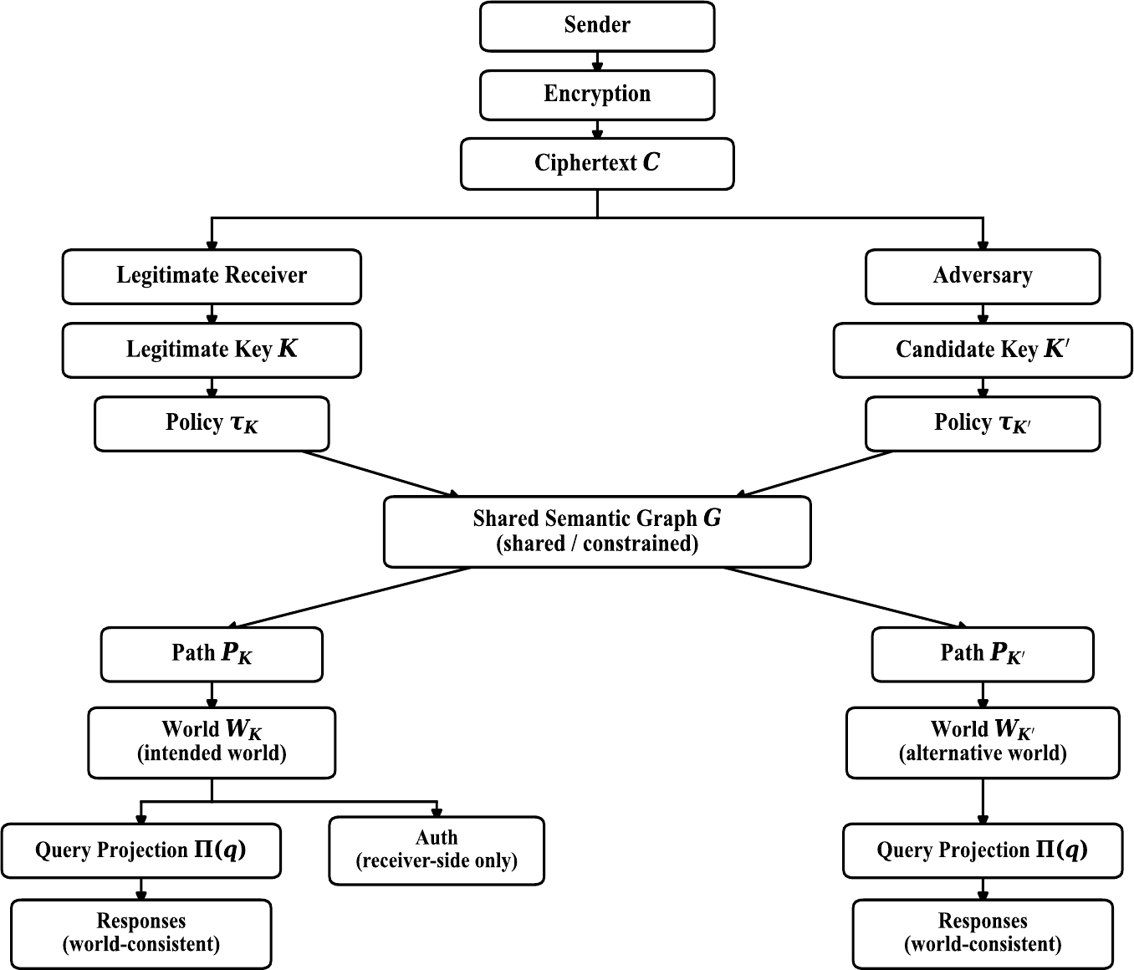
2. System Architecture: One Context, Multiple Worlds
THREE DESIGN COMMITMENTS
01
The key determines a traversal policy, not a plaintext.
02
The shared graph and closure function enforce global coherence.
03
Only the legitimate receiver can validate the intended world.
Fig. 1. MPE system architecture under post-compromise access.
Notes:
This figure shows the full architecture.
The sender establishes an observable semantic context. Candidate keys condition different traversal policies over the same constrained semantic graph, and those paths induce different coherent worlds.
Related queries are projected from one selected world. So, the answers remain mutually consistent, instead of behaving like independent decoys.
There are three design commitments.
First, the key determines a traversal policy, not a plaintext.
Second, the shared graph and closure function enforce global coherence.
Third, only the legitimate receiver can validate the intended world.
Authentication outcomes must never become an adversarial oracle, because a distinguishing validation signal would immediately collapse non-identifiability.

Slide 8
2. System Architecture: Threat Model & Security Goal
ADVERSARY CAN
ADVERSARY CANNOT
Observe candidate worlds and projected outputs
Issue repeated or related queries
Check structural consistency
Rank targets and reconstruct paths
Access receiver-side authentication
Query Auth as an oracle
Observe a validation tag or result
SECURITY GOAL
The intended world remains one of multiple observation-consistent hypotheses: |𝒲 (O)| > 1.
Observation should not uniquely determine the intended world.
Notes:
The adversary is strong in observation but bounded at authentication.
It can inspect candidate worlds and projected outputs, issue repeated or related queries, check structural consistency, rank targets, and reconstruct paths.
It cannot access receiver-side authentication, query authentication as an oracle, or observe a distinguishing validation result. The security objective is world non-identifiability.
After all permitted observations O, the set of observation-consistent worlds, script W of O, still contains more than one member.
Therefore, observation does not uniquely identify the intended world.

Slide 9
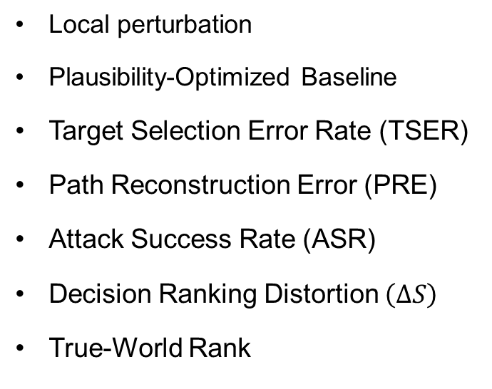
3. Experimental Evidence: Evaluation Design
WORLD REPRESENTATION
ATTACKERS
BASELINES & METRICS
Target
Host or Network Segment
Privilege Level
Attack Action
Dependencies
Timing and Impact
Heuristic ranking
Adaptive querying
No Access to the Authentication Oracle
Local perturbation
Plausibility-Optimized Baseline
Target Selection Error Rate (TSER)
Path Reconstruction Error (PRE)
Attack Success Rate (ASR)
Decision Ranking Distortion $\left(ΔS\right)$
True-World Rank
Each Trial: 1 intended world + D coherent decoy worlds
Configurations (Trials × Decoys): 100 × 10 → 300 × 20 → 1,000 × 30 → 1,000 × 40
Notes:
The evaluation uses a structured cyber scenario.
Each world contains a target, host or network segment, privilege level, attack action, dependencies, timing, and impact.
A trial is one independent experimental run. In each trial, the attacker evaluates one intended world together with D coherent decoy worlds.
For example, one hundred trials by ten decoys means one hundred independent runs, each with eleven candidate worlds.
Trials improve statistical stability. Decoys enlarge the candidate interpretation space.
We report target-selection error, path-reconstruction error, joint attack success, decision-ranking distortion, and the rank of the intended world.

Slide 10
3. Experimental Evidence: Scaling Results
0.660 → 0.805
Target-selection error increases
0.160 → 0.074
Joint attack success decreases
5.72 → 21.65
Intended world is buried deeper
113.8 → 144.4
Ranking distortion increases
Fig. 2. Adversarial performance metrics across scaling and stress-test configurations. (a) Target Selection Error Rate (TSER). (b) Joint target-and-path Attack Success Rate (ASR). (c) Decision Ranking Distortion (ΔS). (d) Average Rank of Intended World.
Notes:
Across the evaluated configurations, target-selection error rises from 0.660 to 0.805, while joint target-and-path success falls from 0.160 to 0.074.
Decision-ranking distortion increases from 113.8 to 144.4. The raw average rank of the intended world increases from 5.72 to 21.65 as the candidate set grows from eleven to forty-one worlds.
Together, these results show that the intended interpretation becomes harder to select and prioritize as coherent alternatives are added.
However, the raw-rank increase must be interpreted carefully, because the candidate count also increases. Raw rank alone does not prove a non-combinatorial effect. The stronger evidence comes from the baseline, ablation, and adaptive-query comparisons at comparable candidate density.

Slide 11
3. Experimental Evidence: Ablation & Baselines
Fig. 3. Ablation and baseline comparison under the high-density setting. (a) Target Selection Error Rate (TSER). (b) Decision Ranking Distortion (ΔS).
41
25.14
5.31
coherent worlds — full MPE
without global coherence
local perturbation baseline
Notes:
The ablation and baseline comparison shows complementary roles for keyed traversal and global coherence.
Full MPE sustains forty-one coherent candidates. Removing global coherence reduces that number to 25.14, while local perturbation produces only 5.31 coherent candidates.
The plausibility-optimized baseline is substantially weaker on the two most decision-relevant measures shown here. Its target-selection error is 33.7 percent, compared with 80.5 percent for full MPE, and its decision-ranking distortion is 104.5, compared with 144.4.
The key point is that a method may misdirect one local choice without generating a scalable set of complete, query-consistent worlds.
Keyed traversal connects variation to the key, while global coherence keeps alternative worlds structurally valid across related observations.

Slide 12
3. Experimental Evidence: Adaptive-Query Results
0.810 vs 0.352
TSER: MPE vs plausibility baseline
158.6 vs 113.0
ΔS: MPE vs plausibility baseline
Fig. 4. Comparison with optimized baselines.
(a) Target Selection Error Rate (TSER). (b) Decision Ranking Distortion (ΔS).
All related answers are projected from the same coherent world.
Notes:
Under the evaluated querying attacker, ambiguity persists.
The attacker repeatedly queries candidate worlds, compares projected responses, and updates its ranking, while authentication remains inaccessible.
MPE reaches a target-selection error of 0.810, compared with 0.352 for the plausibility baseline.
Decision-ranking distortion reaches 158.6, compared with 113.0.
These comparative effects remain significant after Holm correction, which control the family-wise error rate across multiple statistical comparisons.
The structural reason is that related answers are not assembled as isolated decoys; they are projected from the same coherent world.
Additional queries can reveal more local detail without necessarily identifying which world is intended. This supports robustness against the specific querying strategy evaluated here, not against every possible adaptive adversary.

Slide 13
4. Security Meaning & Limits
STATE RECOVERY → HYPOTHESIS SELECTION
WHAT THE EVIDENCE SUPPORTS
CURRENT LIMITS
World non-identifiability under the tested observations
Persistent decision-ranking distortion
Query-consistent ambiguity under repeated interaction
No reduction-based cryptographic guarantee
Bounded semantic graph and cyber scenario
Specific heuristic and querying attackers
Authentication outcomes and distinguishing validation signals must remain inaccessible
An operational security condition, not yet a conventional proof.
Notes:
Conceptually, MPE changes the attacker's problem from recovering one hidden state to selecting among multiple coherent hypotheses.
The experiments support operational world non-identifiability, persistent decision-ranking distortion, and query-consistent ambiguity under the tested conditions.
The boundary is equally important. This is not yet a reduction-based cryptographic guarantee or an information-theoretic bound.
The semantic graph, cyber scenario, and adversary models are bounded, and authentication outcomes or distinguishing validation signals must remain unavailable.
Therefore, the responsible claim is an interpretation-control architecture with operational evidence, not a completed proof of a conventional encryption primitive.

Slide 14
Conclusion
MPE reframes post-compromise security: when access can no longer be prevented, security shifts to controlling what an adversary can reliably infer.
Elevates ambiguity from message-level uncertainty to coherent alternative worlds.
Generates interpretations through key-conditioned, path-dependent traversal.
Enforces global coherence across related queries.
Uses ambiguity for epistemic control rather than mere deception.
Evidence boundary: Under the evaluated threat model, MPE degrades adversarial inference while authentication outcomes and exploitable side-channel signals remain unavailable.
Notes:
In conclusion, MPE reframes post-compromise security.
When access can no longer be prevented, security can still control what an adversary can reliably infer.
It elevates ambiguity from message-level uncertainty to coherent alternative worlds.
It generates interpretations through key-conditioned, path-dependent traversal.
It enforces global coherence across related queries, and it uses ambiguity as a mechanism of epistemic control rather than mere deception.
Under the evaluated threat model, the results show degraded adversarial target selection and ranking, provided that authentication outcomes and exploitable side-channel signals remain inaccessible.

Slide 15
MPE:
Controlling what post-compromise access can reliably reveal.
Thank you!
Notes:
Q1. Is MPE a replacement for conventional encryption?
No. MPE is an interpretation-control layer for post-compromise settings. Conventional encryption, access control, and authentication remain necessary.
Q2. How is MPE different from honey encryption or deniable encryption?
Those approaches typically make incorrect keys yield plausible messages. MPE elevates ambiguity to coherent, queryable worlds generated through key-conditioned traversal and global closure.
Q3. Why can’t repeated queries reveal the intended world?
All projected responses come from the same generated world, so related answers remain internally consistent. The claim depends on Auth remaining unavailable as a distinguishing oracle.
Q4. Does every incorrect key generate a coherent world?
The paper claims this for incorrect but admissible keys. Candidate filtering and global closure reject invalid paths; arbitrary keys are not assumed to guarantee a usable world.
Q5. What prevents the attacker from learning through Auth?
Auth uses receiver-side secret validation material and is never returned through the query projection. If Auth leaks or becomes queryable, world non-identifiability can collapse.
Q6. Do the results provide a formal cryptographic security guarantee?
Not yet. They support operational non-identifiability and decision uncertainty under the evaluated observation model. Formal games, bounds, and reductions are future work.
Q7. What is the main empirical result?
At the 1,000-trial / 40-decoy setting, TSER is 0.805, PRE is 0.926, ASR is 0.074, and the intended world’s average rank is 21.65. Under adaptive querying, MPE TSER remains 0.810.
Q8. What is the main implementation cost?
MPE avoids enumerating a fixed plaintext for every key by using a shared graph and deterministic traversal, but it introduces graph-construction, constraint-checking, traversal, and authentication overhead that still requires scalability testing.

Slide 16
Appendix A. Metric Definitions
Metric | Definition | Security direction
TSER | Pr[attacker selects the wrong target] | Higher
PRE | Pr[attacker reconstructs the wrong path] | Higher
ASR | Pr[target and path are both correct] | Lower
ΔS | Highest decoy score minus intended-world score | Higher
Rank | Average rank position of the intended world | Higher
Target Accuracy = 1 − TSER. ASR should be interpreted cautiously because path reconstruction is difficult across all tested methods.
Notes:
This slide defines the five evaluation metrics. TSER measures target-selection error, and PRE measures path-reconstruction error. ASR is stricter because both the target and the path must be correct. Decision-ranking distortion is the score gap between the highest-ranked decoy and the intended world. Rank records how deeply the intended world is buried. Higher values are favorable for TSER, PRE, distortion, and intended-world rank; lower values are favorable for attack success. ASR should be interpreted cautiously because path reconstruction is difficult across all tested methods.

Slide 17
Appendix B. Full Scaling and Statistical Results
Config. | TSER | PRE | ASR | Target acc. | ΔS | Avg. rank
100 / 10 | 0.660 | 0.840 | 0.160 | 0.340 | 113.8 | 5.72
300 / 20 | 0.733 | 0.903 | 0.097 | 0.267 | 134.2 | 10.96
1000 / 30 | 0.780 | 0.925 | 0.075 | 0.220 | 141.9 | 16.48
1000 / 40 | 0.805 | 0.926 | 0.074 | 0.195 | 144.4 | 21.65
HEURISTIC ATTACKER
QUERYING ATTACKER
TSER: 0.805 vs 0.337 · z = 21.14 · p = 3.14×10⁻⁹⁹
ΔS: 144.4 vs 104.5 · U-score = 13.05 · p = 6.25×10⁻³⁹
TSER: 0.810 vs 0.352 · z = 20.76 · p = 1.07×10⁻⁹⁵
ΔS: 158.6 vs 113.0 · U-score = 14.49 · p = 1.39×10⁻⁴⁷
All reported comparative effects remain significant after Holm correction.
Notes:
This slide provides the complete scaling table and the principal significance tests. Under both the heuristic and querying attackers, the comparative target-selection and decision-ranking effects remain significant after Holm correction. For the heuristic attacker, TSER is 0.805 versus 0.337, and Delta S is 144.4 versus 104.5. For the querying attacker, TSER is 0.810 versus 0.352, and Delta S is 158.6 versus 113.0. These tests support the conclusion that the reported comparative effects are not explained by random variation within the evaluated configurations.

